Slide 1

KS3 Mathematics
D2 Calculating the mean
Notes:
The aim of this unit is to teach pupils to:
Calculate statistics from data, using ICT as appropriate, finding the mode, mean, median and range
Material in this unit is linked the Framework’s supplement of examples pp256 –261.

Slide 2


The mean
The mean is the most commonly used average.
To calculate the mean of a set of values we add together the values and divide by the total number of values.
Sum of values
Mean =
Number of values
For example, the mean of 3, 6, 7, 9 and 9 is
3 + 6 + 7 + 9 + 9
34
=
= 6.8
5
5

Slide 3
Problems involving the mean
A pupil scores 78%, 75% and 82% in three tests. What must she score in the fourth test to get an overall mean of 80%?
To get a mean of 80% the four marks must add up to
4 × 80% = 320%
The three marks that the pupils has so far add up to
78% + 75% + 82% = 235%
The mark needed in the fourth test is
320% – 235% =
85%
Notes:
Start by asking students what other four scores would give overall mean of 80%.
Explain why any four scores must add up to 320% to give a mean of 80%.
Encourage pupils to check the answer by adding 78, 75, 82 and 85 and dividing by four.

Slide 4
Calculating the mean from a frequency table
The following frequency table shows the scores obtained when a dice is thrown 50 times.
What is the mean score?
Score
1
2
3
4
5
6
Total
Frequency
8
11
6
9
9
7
50
Score × Frequency
8
22
18
36
45
42
171
171
The mean score =
= 3.42
50
Notes:
Explain that to find the mean score we need to find the total score altogether. A 1 was scored 8 times and so we can find the score obtained by throwing 1s by multiplying 8 × 1. A 2 was scored 11 times and so we can find the score obtained by throwing 2s by finding 11 × 2. Conclude that we need to find the score × the frequency for each score. Show how this can be done by revealing the yellow row in the table.
We can then record the total number of throws and the total score in the blue column. The mean is found by dividing these totals.

Slide 5
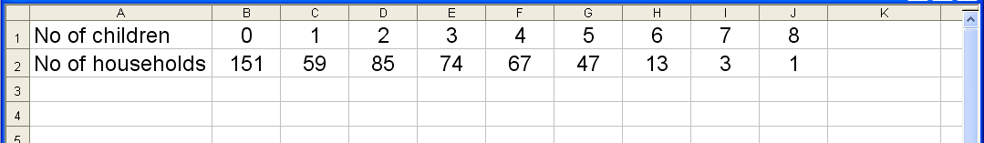
Calculating the mean using a spreadsheet
When processing large amounts of data it is often helpful to use a spreadsheet to help us calculate the mean.
For example, 500 households were asked how many children under the age of 16 lived in the home. The results were collected in a spreadsheet.
Notes:
Discuss how a spreadsheet can be used to find the mean for larger amounts of data.

Slide 6
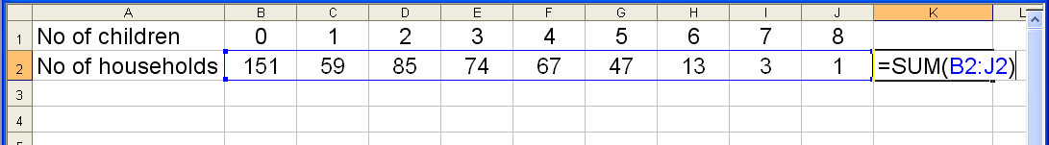
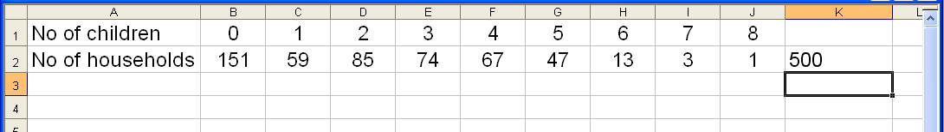
Calculating the mean using a spreadsheet
The total number of households is found by entering =SUM(B2:J2) in cell K2 as follows:
Pressing enter shows the number of households.

Slide 7
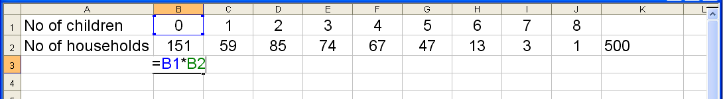
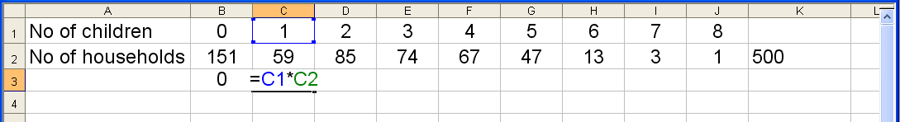
Calculating the mean using a spreadsheet
The total number of children in households with no children is found by entering =B1*B2 into cell B3.
The total number of children in households with one child is found by entering =C1*C2 into cell C3.

Slide 8
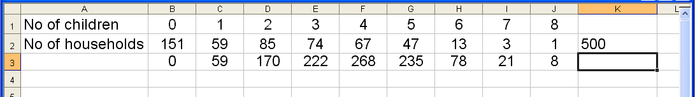
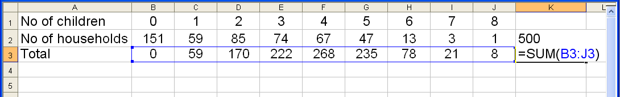
Calculating the mean using a spreadsheet
This can be repeated along the row to find the total number of children in each type of household.
To find the total number of children altogether enter =SUM(B3:J3) in cell K3.

Slide 9
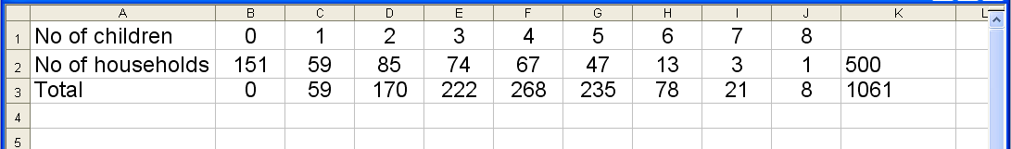
Calculating the mean using a spreadsheet
The mean number of children in each household is now found by dividing the number in cell K3 by the number in cell K2.
1061
Mean number of children =
= 2.122
500
Notes:
Explain that it is a good idea to create a cell containing the formula =K3/K2. This cell will calculate the mean number of children. The advantage of entering this as a formula is that if any of the values in the table are changed, the mean will be recalculated automatically.

Slide 10
Using an assumed mean
We can calculate the mean of a set of data using an assumed mean.
For example, suppose the heights of ten year 8 pupils are as follows:
148 cm, 155 cm, 145 cm, 157 cm, 156 cm,
142 cm, 168 cm, 152 cm, 150 cm, 138 cm.
To find the mean of these values using an assumed mean we start by making a guess at what the mean might be. This is the assumed mean.
For this set of values we can use an assumed mean of 150 cm.
Notes:
Point out that the assumed mean is going to be subtracted from each of the values in the set of data. It makes sense, therefore, to choose a value that is easy to subtract, such as a value that has been rounded to the nearest 10.
Point out, that it doesn’t really matter what this value is as long as it is easy to subtract and the resulting differences are easy to add. The aim is to make the values smaller so that we can calculate the mean mentally.

Slide 11
Using an assumed mean
Subtract the assumed mean from each of the data values.
148 cm, 155 cm, 145 cm, 157 cm, 156 cm,
142 cm, 168 cm, 152 cm, 150 cm, 138 cm.
– 150 cm
–2 cm, 5 cm, –5 cm, 7 cm, 6 cm,
–8 cm, 18 cm, 2 cm, 0 cm, –12 cm.
Next, find the mean of the new set of values.
38 – 27
11
=
= 1.1
10
10
Notes:
Point out that when we add together lots of numbers where some are positive and some are negative, it is often easier to add the positive numbers together and then add the negative numbers together. That way, we only have a single subtraction to do at the end of the calculation.
If we add together the positive values we get 38 and if we add the negative values together we get –27. The new set of values therefore have a sum of 11.

Slide 12
Using an assumed mean
To find the actual mean of the heights, add this value to the assumed mean.
150 + 1.1 = 151.1
assumed mean
mean of the differences
actual mean
So, the actual mean of the heights is 151.1 cm.
This method is often used to find the mean of numbers that are large or written to a large number of decimal places.
We can use this method to find the mean mentally, using jottings.

Slide 13
Using an assumed mean
In summary, to find the mean of a set of values using an assumed mean follow these steps:
1) Assume the mean of the values.
2) Subtract this assumed mean from each of the values.
3) Find the mean of the new values.
Add this mean to the assumed mean to find the actual
mean.
Sum of the differences
Actual mean = Assumed mean +
Total number of values

